Slide 1
DPRS v0.0
Dynamic Programming and Random Stuff
By Mohammad Samiul Islam

Slide 2
Postal Van
Live Archive 2738 - Postal Vans

Slide 3
Component DP

Slide 4
More Problems on Component DP
SRM 312 - CheapestIsland
Timus 1519. Formula 1
LOJ 1312 - Electricity Connection
SPOJ MAZE - The Long and Narrow Maze

Slide 5
Turning in Homework
POJ 1991 Turning in Homework

Slide 6
Interval DP

Slide 7
Hints for “Turning in Homework”
Let us call the classes whose homework Bessie has turned covered and others uncovered. Notice that, at any given moment, there exists a continuous segment of uncovered classes. So, as long as we keep track of leftmost and rightmost uncovered class, we can formulate a interval DP.
But what if there isn't a continuous segment of uncovered class at any given moment? What if there are three classes A, B and C, where A,C are not covered but B is covered? Without loss of generality, let us say that Bessie is at A. Now, since C is not covered, Bessie has to travel from A to C. Now while traveling, she will pass through class B. So covering B before this moment is same as covering it while traveling from A to C, cause ultimate result will be same. Hence, there is no point in covering the classes such that it doesn't form continuous segment of uncovered class.
Therefore, we can get the optimal result by covering the classes from either of the ends, zigzagging between the two ends. Hence we need to keep three parameters - leftmost uncovered class, rightmost uncovered class, the end where Bessie currently is. Using these three parameters and some calculation, we can design an interval DP.

Slide 8
More Problems on Interval DP
POJ 3042 - Grazing on the Run (Hints)

Slide 9
Biathlon 2.0
CF 100886H Biathlon 2.0
Notes:
Basically, given a set of points S and a query point q. Find the minimum dot product between the q and all points in S.

Slide 10
Convex Hull Trick

Slide 11
Convex Hull Trick
Convex Hull Trick (CHT) is a data structure.
CHT supports the following operation:
Add line: Add a line in the set S of the form Mx + B, where M is the gradient and B is the y-intercept
Query x: Minimum value we get when lines in the set are evaluated at position x.
Notes:
Offline vs Online. Offline is easier.

Slide 12
Convex Hull Trick: Theory
If we draw all the lines on a paper, and then for each X highlight the point (X,Y), where Y is the lowest value we get if we evaluate all lines in set S with X, then we will get a upper-convex hull.
The upper-convex hull is all we need to answer our query. Therefore, if we can get the coordinates of the segments of the convex-hull, then we can easily evaluate for any value X using binary search.
There are two ways we can implement this DS: Offline and Online. The offline version is much simpler than online.
Notes:
Draw the upper convex hull

Slide 13
Convex Hull Trick: Offline
We are given all the lines and queries beforehand.
The upper convex hull will have segments from left to right in decreasing gradient. So we will sort all lines with decreasing value of M and in case of tie, increasing value of B.
Next, we will use a stack to maintain the subset of lines that form the upper-convex hull. The first line will always be in the stack. It will never be popped out.
Then for each line, either it will be pushed in the stack or it will be ignored. If the current line has same gradient as the top of stack, then ignore it, else push it into the stack. This new addition will make some lines in the convex hull invalid. Find those invalid lines and remove them.
How do we find the invalid lines? Take the top 3 lines of the stack, l₁, l₂ and l₃. l₂ will become invalid if intersection of l₁ and l₂ is on right of intersection of l₁ and l₃.
Code in C++
Notes:
Explain #2 with drawings

Slide 14
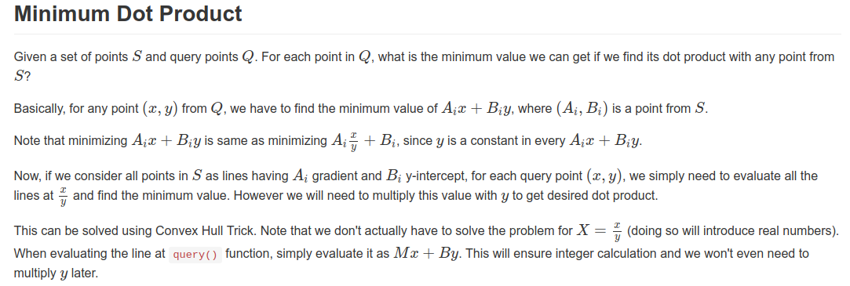
Biathlon 2.0 Hints

Slide 15
Land Acquisition
SPOJ ACQUIRE - Land Acquisition

Slide 16
Land Acquisition
Irrelevant rectangles
Contiguity
O(N^2) DP solution
Convexity
O(N) DP + O(N log N) Sort

Slide 17
Convex Hull Optimization

Slide 18
More Resources on Convex Hull Optimization
Problems
HDU 2993 - MAX Average Problem
CF 311/B - Cats Transport
SPOJ APIO10A - Commando
HDU 3480 - Division
HDU 2829 - Lawrence
Articles
Codeforces Dynamic Programming Optimizations
WCIPEG Convex Hull Trick

Slide 19
In case we still have more time….
POJ 3613 Cow Relays (Hints)
SPOJ CLEVER - The Clever Typist
UVa 10313 - Pay the Price

Slide 20
Thank You

